Slide 1
Lecture 17
Canvas Drawing

Slide 2
Introduction
When Canvas Drawing is processed, the framework calls the draw method at the top of the view tree.
This time the call is propagated preorder, each view drawing itself before it calls its children. This means that leaf views are drawn after their parents.
The draw method calls onDraw.
When your widget’s onDraw method is called, it must render itself according to the current application state.
In order to prevent extra painting, the Android UI framework maintains some state information about the view, called the clip rectangle.

Slide 3
Rules of Canvas Drawing
Drawing code should be inside the onDraw method.
A widget should draw itself as quickly as possible when onDraw is invoked.
The middle of the call to onDraw is no time to run a complex database query or to determine the state of some services.
All the state and resources you need to draw should be ready for use, at drawing time.
Long-running tasks should be used by a separate thread.

Slide 4
Drawing Classes
Canvas (subclass of android.graphics.Canvas) :-It used to draw graphics in android. It provides methods to draw oval, rectangle, picture, text, line etc. It maintains the clip rectangle also.
Paint (subclass of android.graphics.Paint) :- It used with canvas to draw objects. It holds the information of color and style.
Bitmap (subclass of android.graphics.Bitmap) :- This is the paper you are drawing on. It holds the actual pixels that you draw.
Drawable (subclass of android.graphics.Drawable):-This is the thing you want to draw like rectangle or image.

Slide 5
Example of Canvas Drawing
Take a project in android by name of CanvasDrawingApp.
Code of activity_main.xml:-
<RelativeLayout
android:layout_width=“fill_parent”
android:layout_height=“fill_parent” >
</RelativeLayout>
Note:- We will draw all widgets by Java Code only.

Slide 6
Example of Canvas Drawing
Code of MainActivity.java file:-
package com.example.CanvasDrawingApp;
public class MainActivity extends Activity {
DemoView dv;
public void onCreate(Bundle savedInstanceState) {
super.onCreate(savedInstanceState);
dv = new DemoView(this);
setContentView(dv);
}
public class DemoView extends View{
// Constructor Function
public DemoView(Context context){
super(context);
}

Slide 7
Example of Canvas Drawing
protected void onDraw(Canvas canvas) {
super.onDraw(canvas);
// custom drawing code here
Paint p = new Paint();
p.setStyle(Paint.Style.FILL);
// make the entire canvas white
p.setColor(Color.WHITE);
canvas.drawPaint(p);
// AntiAlias use for making smooth edges of Drawing Widgets
// draw blue circle with anti aliasing turned off
p.setAntiAlias(false);
p.setColor(Color.BLUE);
canvas.drawCircle(20, 20, 15, p);
// draw green circle with anti aliasing turned on
p.setAntiAlias(true);
p.setColor(Color.GREEN);
canvas.drawCircle(60, 20, 15, p);

Slide 8
Example of Canvas Drawing
// draw red rectangle with anti aliasing turned off
p.setAntiAlias(false);
p.setColor(Color.RED);
canvas.drawRect(100, 5, 200, 30, p);
// draw the rotated text
canvas.rotate(-45);
p.setStyle(Paint.Style.FILL);
canvas.drawText("Graphics Rotation", 40, 180, p);
//undo the rotate
canvas.restore();
}
}
}

Slide 9
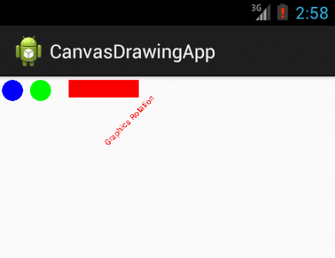
Output

